Slide 1
Data Analysis

Slide 2
Get Data And Analyze.
by info() method is useful to get a quick description of the data, for example(the total number of rows, and each attribute’s type).
By describe() method shows a summary of the numerical attributes .
call the hist() method, to get a feel of the type of data with is to plot a histogram for each numerical attribute.

Slide 3
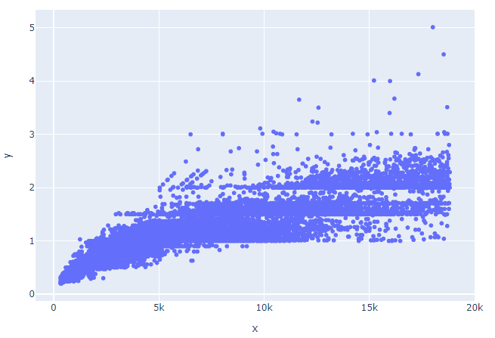
create a scatterplot to visualize the data
Create a scatter chart to show the correlation between price and carat.

Slide 4
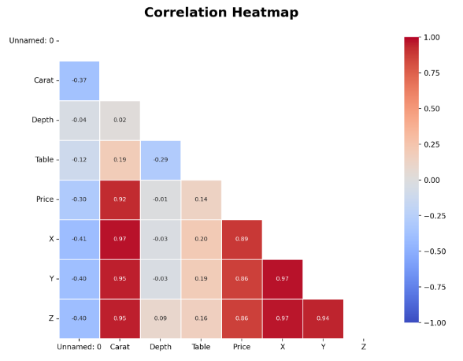
making a correlation heatmap

Slide 5
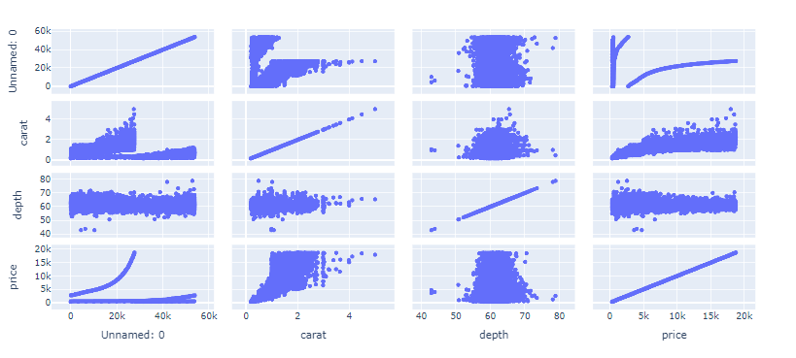
Making a scatter matrix for further analysis

Slide 6
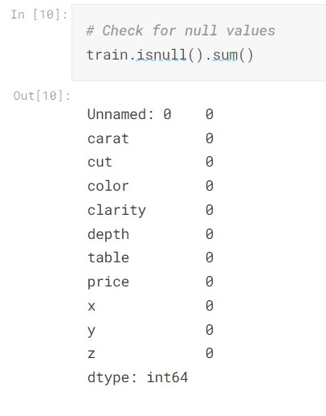
2. Data Preparation
Data Cleaning:
The first step in data preparation is to check for
Null values.
There are no null values in our data.

Slide 7
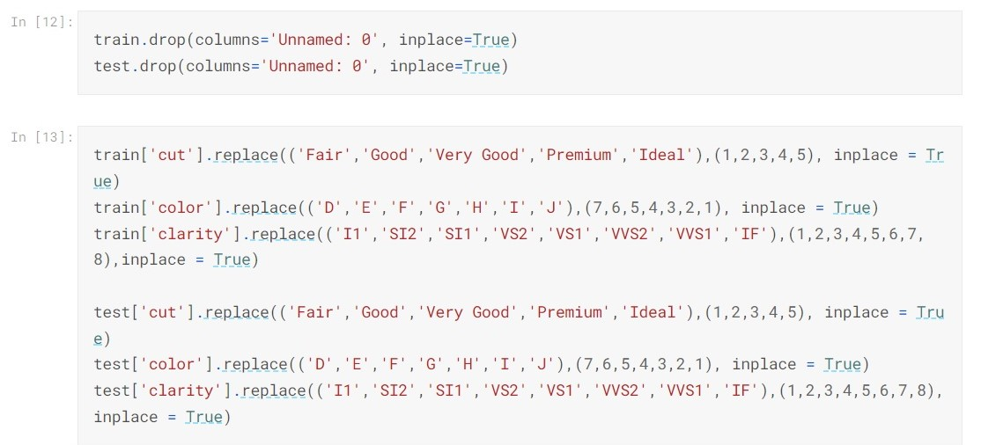
Handling Text and Categorical Attributes:
We first dropped the first column in the test and train data.
In this dataset, there are three categorical attributes: 1. cut, 2. color, 3. and clarity.
And since there are three categorical attributes in our data, it was easier to simply assign the letters to a certain number in each categorical column

Slide 8
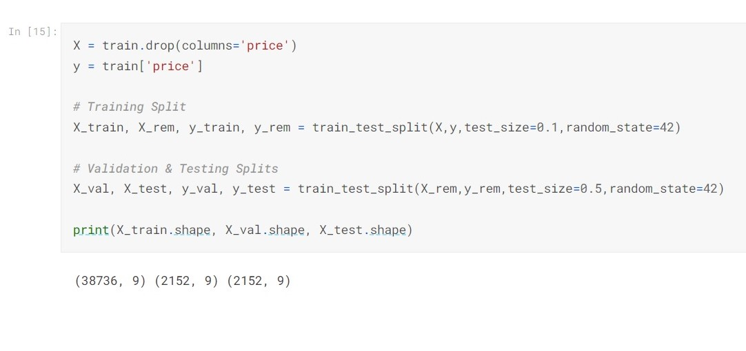
Splitting the data:

Slide 9
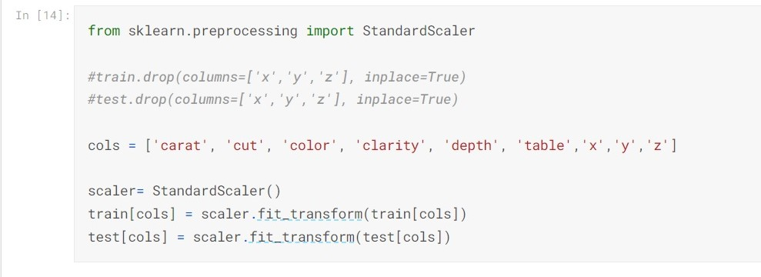
Feature Scaling:
In this pipeline we have the StandardScalar transformer. We used the standardization because it is much less affected by outliers than the min-max scalar. We applied the scalar for both the train and test data.

Slide 10
Modeling Phase

Slide 11
Make Accuracies Function
This function takes the model as an input.
The output for the model is the R2 score and the RMSE for the Training, Validation, and Testing sets
This function shows if the model is overfitting the training data, underfitting, and even data mismatch
The purpose of making this function is to re-use the function every time I want to test a new machine learning algorithm.

Slide 12
Machine Learning Algorithms
We’ve tried multiple machine learning models such as:
Linear Regression
KNN
Decision Tree
Random Forest
XGBoost
The model that gives the best performance is the XGBoost model.

Slide 13
XGBoost Performance
We’ve applied the Accuracies function we made on this model, and we got these results:
Training set:
R2 = 0.99
RMSE = 368
Validation set:
R2 = 0.98
RMSE = 517
Testing set:
R2 = 0.98
RMSE = 548

Slide 14
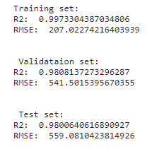
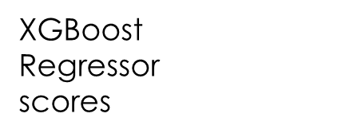
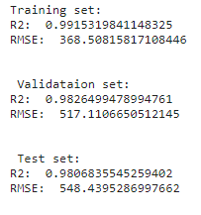
4. Model Tuning
Checking out the best models:
Looking at the models we got the XGBoost model and the Random forest model with the highest R2 and lowest RMSE scores
Random
Forest
Regressor
scores

Slide 15
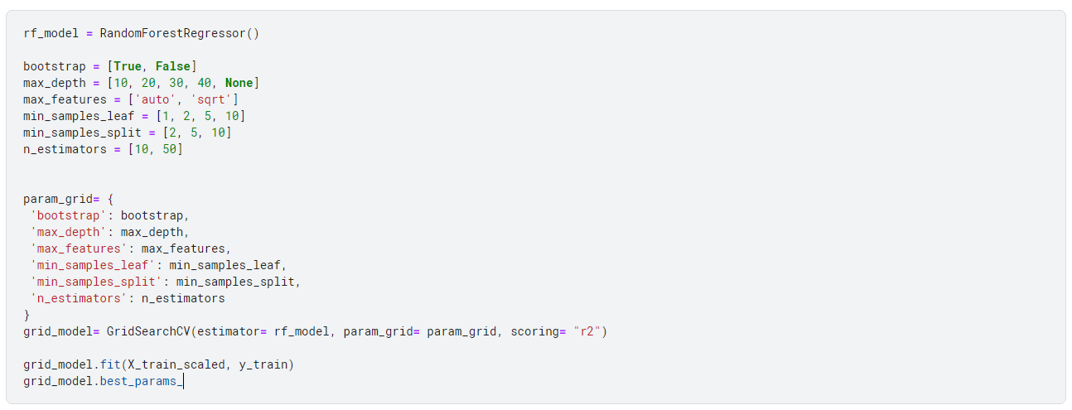
- Using GridsearchCV on Random Forest Regressor
Using GridsearchCV is the best way to find the optimal parameters, We started with Random Forest Regressor, The following code is for testing
these parameters and ensure that it picks the optimal combination.

Slide 16
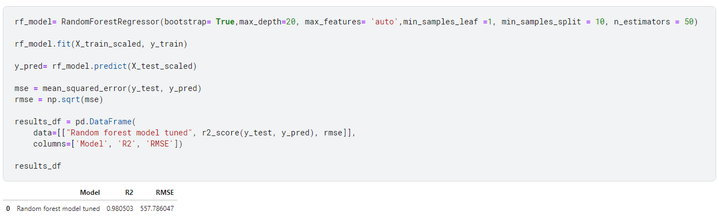
- The optimal parameters (RF)
After tuning the model, we notice that the R2 score didn’t change at all, But the RMSE score did go slightly lower than before.

Slide 17
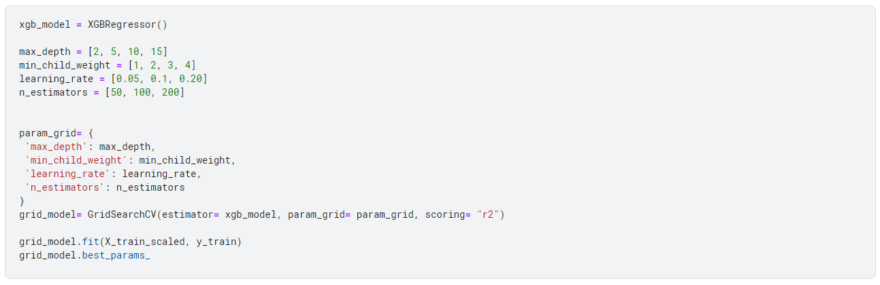
- Using GridsearchCV on XGBoost Regressor
Here we also use GridsearchCV on XGBoost regressor model to find the optimal parameters.

Slide 18
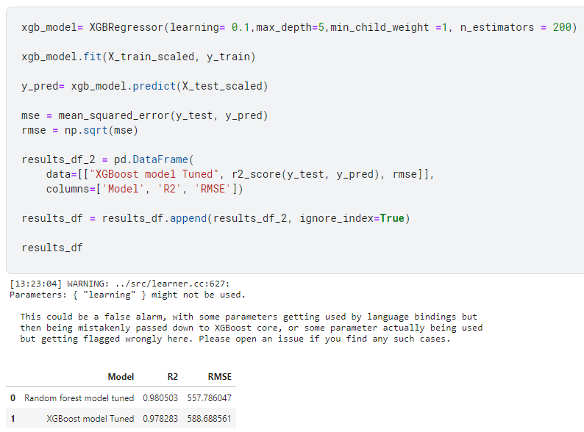
- The optimal parameters (XGB)
After tuning the model, we notice that the R2 score sadly did go lower and the RMSE score did go higher, Which means the XGBoost was poorly tuned.

Slide 19
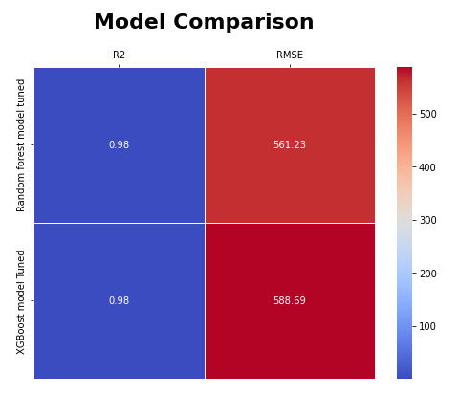
- Model Comparison
We also did a model comparison heatmap plot to summarize the entire tuning results.

